Slide 1
Exploratory Data Analysis of E-Commerce Sales Data
Presented by:
Hemali Sheth NextHikes IT Solutions

Slide 2
PROJECT OBJECTIVE
Understanding Customer & Sales Behaviour
The objective of this project is to analyze e-commerce sales data and identify meaningful patterns in:
* Customer demographics and purchasing behaviour
* Product categories and sales performance
* Order value, quantity and discount patterns
* Payment, shipping and delivery behaviour
* Relationships between different business variables
Business Goal
To convert raw sales data into clear business insights that can support better decision-making.

Slide 3
DATASET OVERVIEW
E- Sales Dataset
Dataset Size
610 Rows
18 Columns
Data Covers
Customer information
Order details
Product & pricing information
Discounts and final sales valueCommerce
Payment & shipping details
Delivery and return information

Slide 4
Key Variables
Customer: Age, Gender, City, State, Customer Type
Sales: Product Price, Quantity, Discount, Final Price
Operations: Payment Method, Shipping Type, Delivery Days, Return Status
Purpose:
To understand customer behaviour, sales patterns and operational performance through data analysis.

Slide 5
DATA UNDERSTANDING & DATA QUALITY
Data Quality Checks
Missing Values
No missing values found in the dataset.
Data Structure
610 records
18 variables
Numeric and categorical variables are present.
Duplicate Check
Duplicate records were checked before analysis.

Slide 6
Data Understanding
Customer, product, sales, payment, shipping and return-related fields were examined.
Result
The dataset was sufficiently structured and ready for Exploratory Data Analysis.

Slide 7
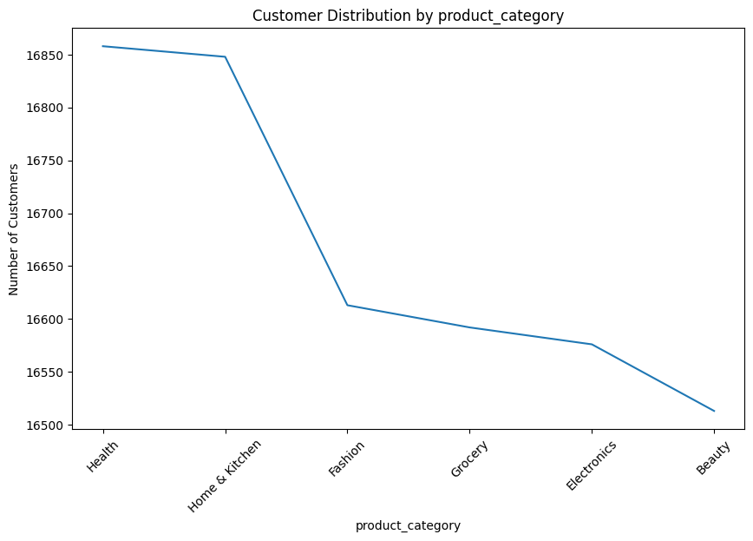
CUSTOMER & SALES OVERVIEW
What does the customer base look like?
Key Analysis
Customer distribution was analyzed across different demographic categories.
Sales were compared across product categories.
This helps identify where customers are concentrated and which categories contribute more to sales value.
Key Finding
Home & Kitchen recorded the highest total sales value among the product categories analyzed.

Slide 8
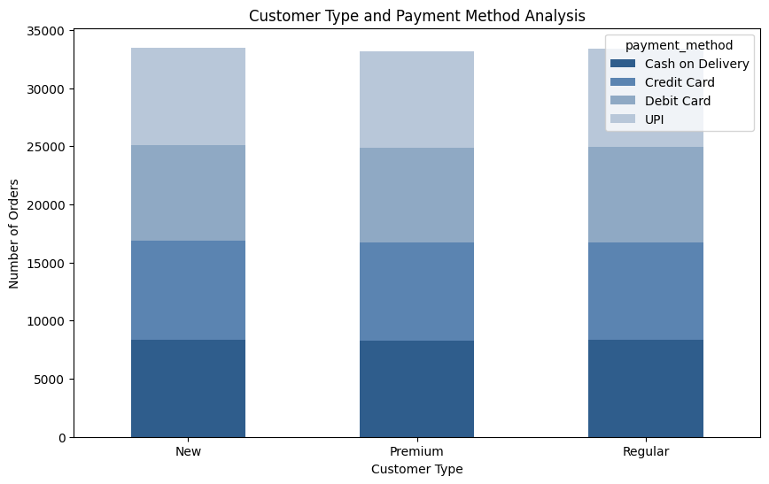
CUSTOMER & PAYMENT BEHAVIOUR
How do customers choose their payment methods?
The analysis compares customer types with their preferred payment methods to understand transaction behaviour.
Key Areas
Customer Type
Payment Method
Number of Orders
Business Relevance
Understanding payment preferences can help businesses improve the checkout experience and provide suitable payment options for different customer groups.

Slide 9
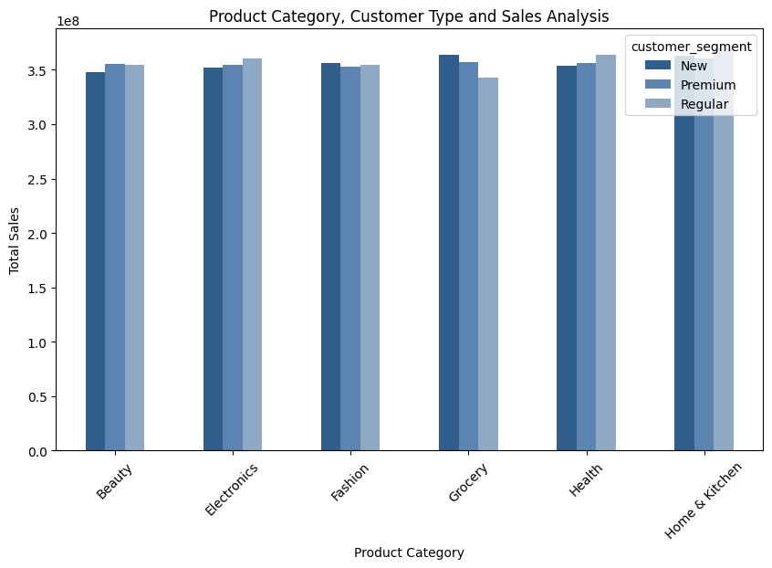
SALES RELATIONSHIPS
What factors are closely related to Sales Value?
The analysis examines the relationship between product price, order quantity and final sales value.
Key Findings
Product Price → Final Price
A strong positive relationship was observed between product price and final price.
Quantity → Final Price
A moderate positive relationship was observed between order quantity and final price.
Business Relevance
Higher-priced products and larger order quantities are generally associated with higher transaction values.

Slide 10
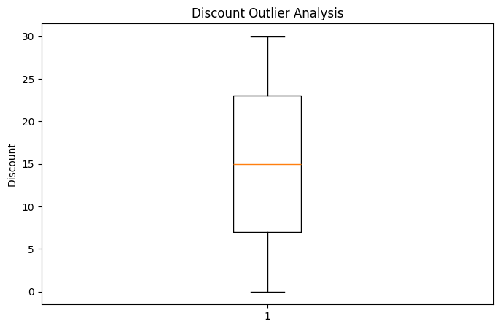
OUTLIER ANALYSIS
Identifying Unusual Data Points
Box plots were used to identify unusually high or low values in important numeric variables.
Variables Analysed
Age
Quantity
Discount Percentage
Delivery Days
Why It Matters
Outlier analysis helps identify unusual customer behaviour, order quantities, discounts and delivery durations that may require further investigation.
Key Finding
Age showed a relatively normal distribution with no major outlier concern

Slide 11
CORRELATION & KEY RELATIONSHIPS
Understanding Relationships Between Variables
Correlation analysis was used to identify how numeric variables are related to each other.
Key Findings
- Product Price & Final Price: Strong positive relationship (0.73)
- Quantity & Final Price: Moderate positive relationship (0.58)
- Discount & Final Price: Weak negative relationship (-0.14)
- Age & Final Price: Almost no linear relationship
Key Takeaway
Product price and order quantity show stronger relationships with final sales value than age or discount.

Slide 12
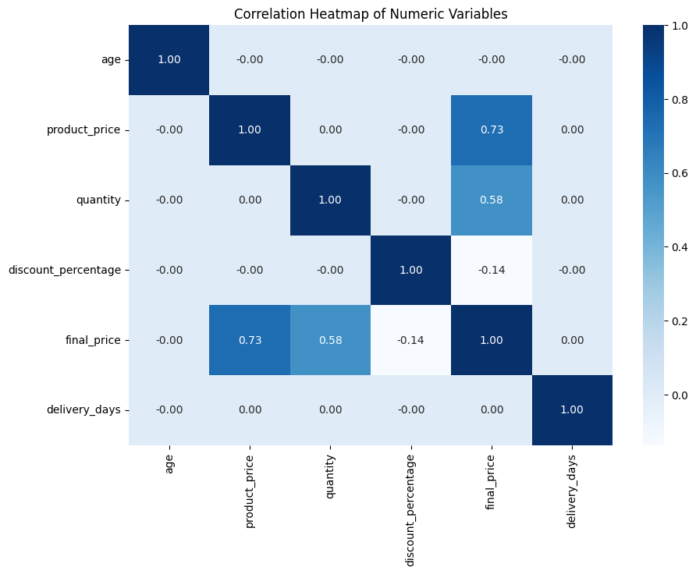

Slide 13
DISTRIBUTION ANALYSIS
Understanding the Shape of the Data
Skewness and kurtosis were used to understand the distribution and behaviour of important numeric variables.
Key Findings
- Final Price: Moderately right-skewed, indicating some comparatively high-value transactions.
- Age: Nearly symmetric distribution.
- Product Price & Quantity: Approximately symmetric distributions.
- Delivery Days: Nearly symmetric distribution.
- Final Price Kurtosis: Close to normal kurtosis, with no extreme tail behaviour indicated by this measure.
Key Takeaway
Final Price shows the most noticeable distribution pattern among the key numeric variables.

Slide 14
KEY BUSINESS INSIGHTS
What did the analysis reveal?
1. Home & Kitchen recorded the highest total sales value.
2. Product Price has a strong positive relationship with Final Price.
3. Order Quantity has a moderate positive relationship with Final Price.
4. Final Price shows a moderate right-skewed distribution.
5. Some transactions have comparatively higher sales values.
6. Age has almost no linear relationship with Final Price.
7. Delivery Days have almost no linear relationship with Final Price.
8. Customer groups show differences in their payment behaviour.
9. The dataset contains no missing values.
10. Product pricing and order quantity show stronger relationships with sales value than age.

Slide 15
BUSINESS RECOMMENDATIONS & CONCLUSION
Business Recommendations
Focus on categories with higher sales contribution.
Monitor product pricing and order quantity to understand sales value.
Review unusually high-value transactions for better business understanding.
Use customer payment patterns to improve the checkout experience.
Monitor delivery performance across different shipping methods.
Conclusion
This project transformed raw e-commerce data into meaningful customer, sales and operational insights.
The analysis highlights the key factors associated with sales value and provides a data-driven foundation for better business decision-making.

Slide 16
THANK YOU

